Slide 1
Our Lady of Consolation
Liturgical Ministry Training
Welcome!

Slide 2
Let us pray…

Slide 3
Thanks for your ministry.
Thanks for your interest.
Thanks for attending this training.
If you are a veteran, thank you so much for your ministry.
If you are new, thanks for offering to join us.

Slide 4
Tonight:
Refresh our training to both the lector and communion ministries.
Renew our veterans. Train new volunteers.
Introduce a few changes.

Slide 5
Tonight - continued
Pass out materials & Workbooks.
Sign up new ministers – registration form.
Mass preference
Schedule link to family members

Slide 6
Lector Ministry

Slide 7

In the Mass the table both of God’s Word and of Christ’s body is prepared…
…from which the faithful may be instructed and refreshed.
                GIRM #28

Slide 8
God is speaking to us.
When the scriptures are read; it is as if the book disappears.
The lector becomes the mouthpiece of God.
God uses the voice of the lector to say something that applies to the world today.
The lector does not just pronounce words –
the lector communicates a divine message.

Slide 9
Rule of St Benedict (d. 543 AD)
Anyone can read Scriptures in public…
…only a believer can proclaim them.

Slide 10
Preparation is key!

Slide 11
The most important preparation for being able to proclaim the Word of God well:
  A heart which regularly converses with God.
  A life which is lived in faithful service.

Slide 12
Preparation I
Read all of the readings for the day
Take it in – what word or phrase strikes you? remains with you?
Be challenged by it – how does it give life to me?

Slide 13
Preparation II
Do I have the proper pronunciations?
Have I studied the Workbook for suggestions on voicing, inflection and emphasis?

Slide 14
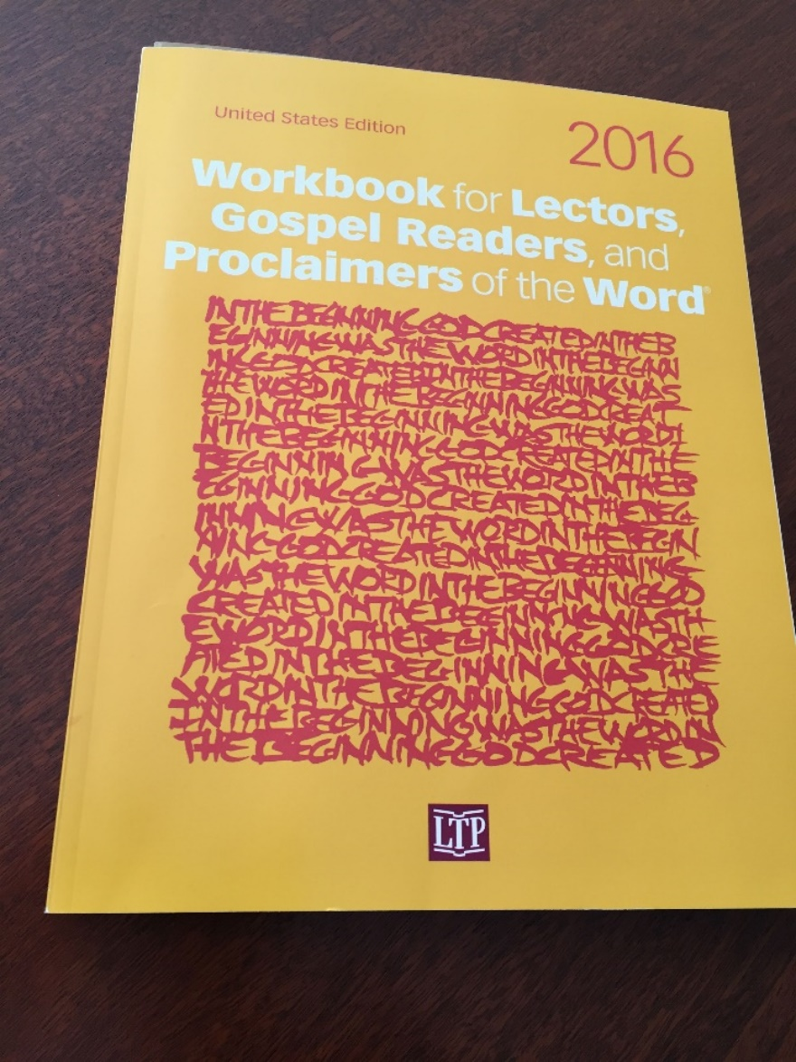
WORKBOOK

Slide 15
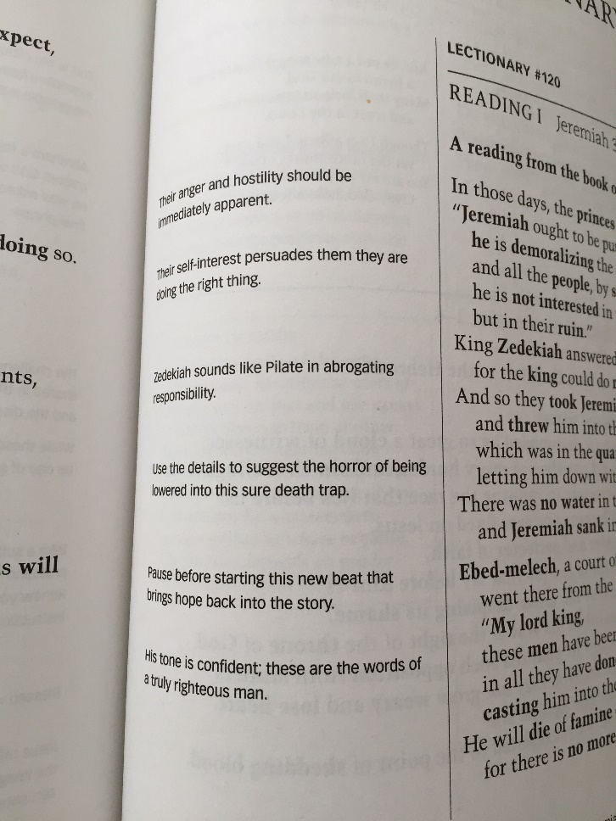
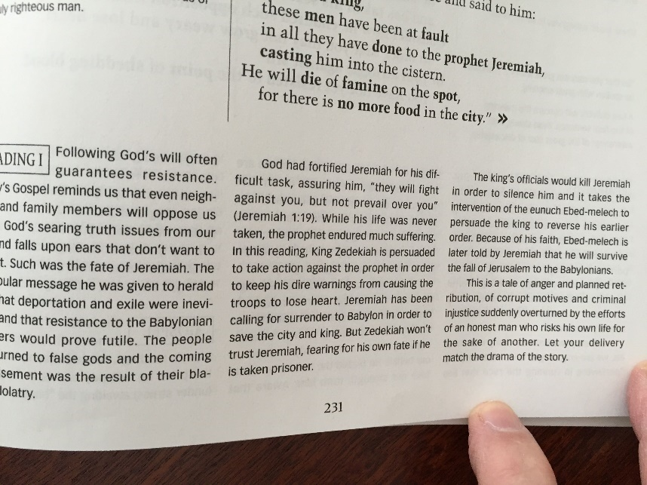
Workbook assistance:

Slide 16
Physical Preparation III
Know the room and furnishings.
Where will I sit?
Know the sound system, microphone
Is the Lectionary ready?

Slide 17
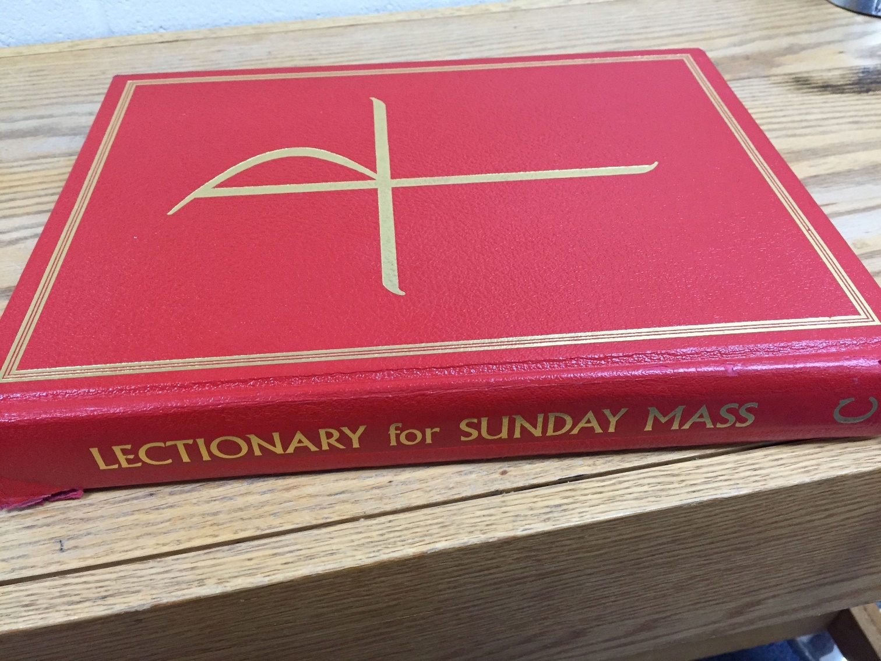
Lectionary

Slide 18
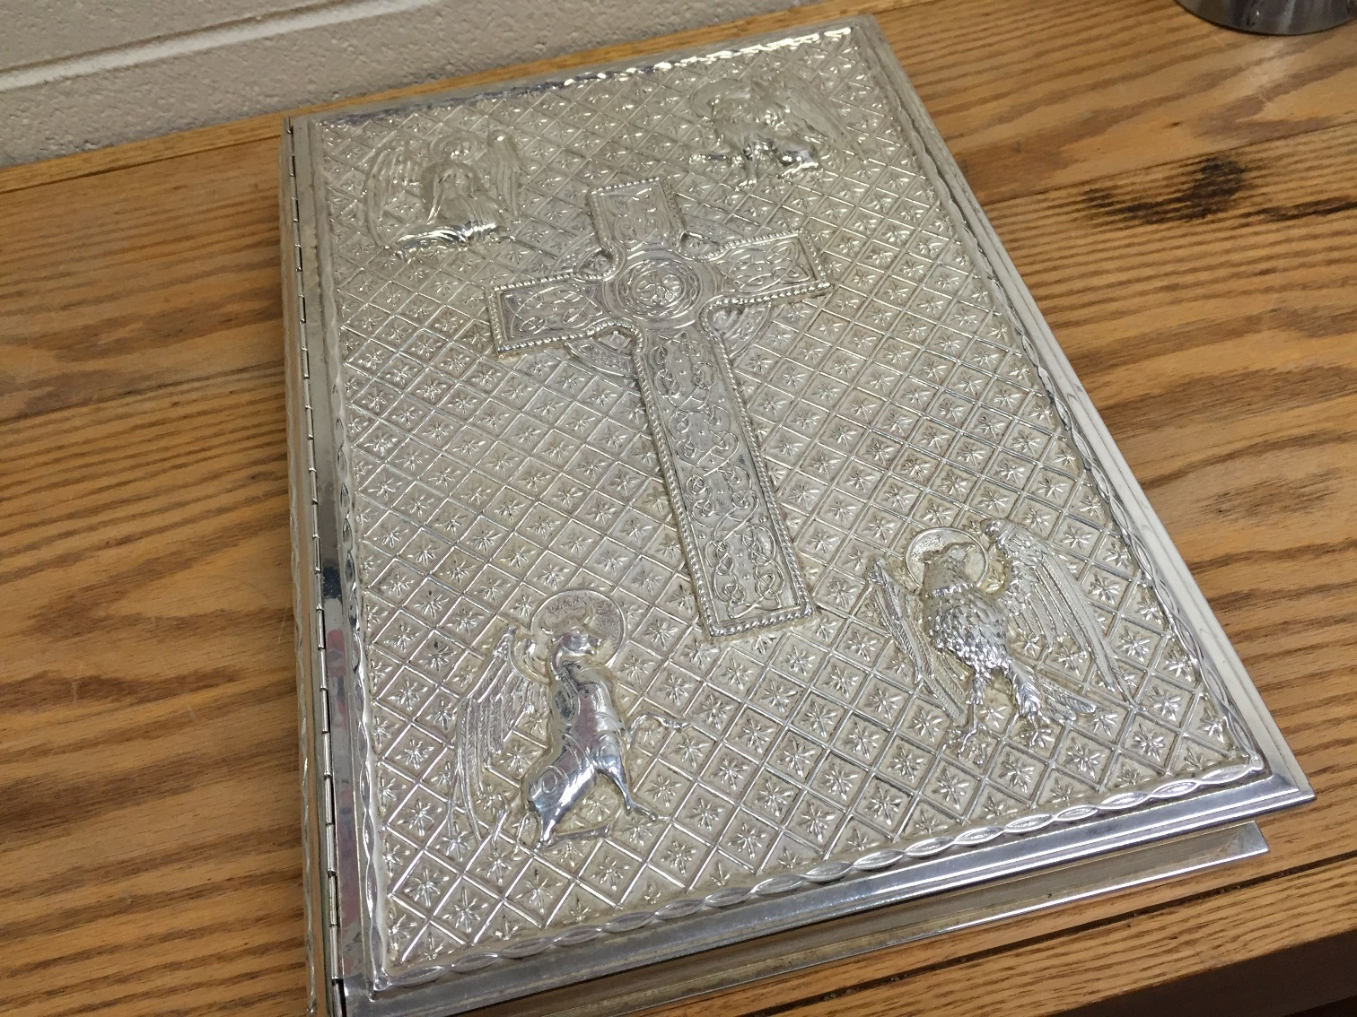
Book of the Gospels

Slide 19
Physical Preparation III
- continued
Is the other reader here?
Is the deacon here? If not, will I be carrying in the Book of the Gospels?
(New) If the deacon is not present, review the General Intercessions (Prayers of the Faithful).

Slide 20
This new…
The Bishop has asked that, when present, the deacon read the Prayers of the Faithful.

Slide 21
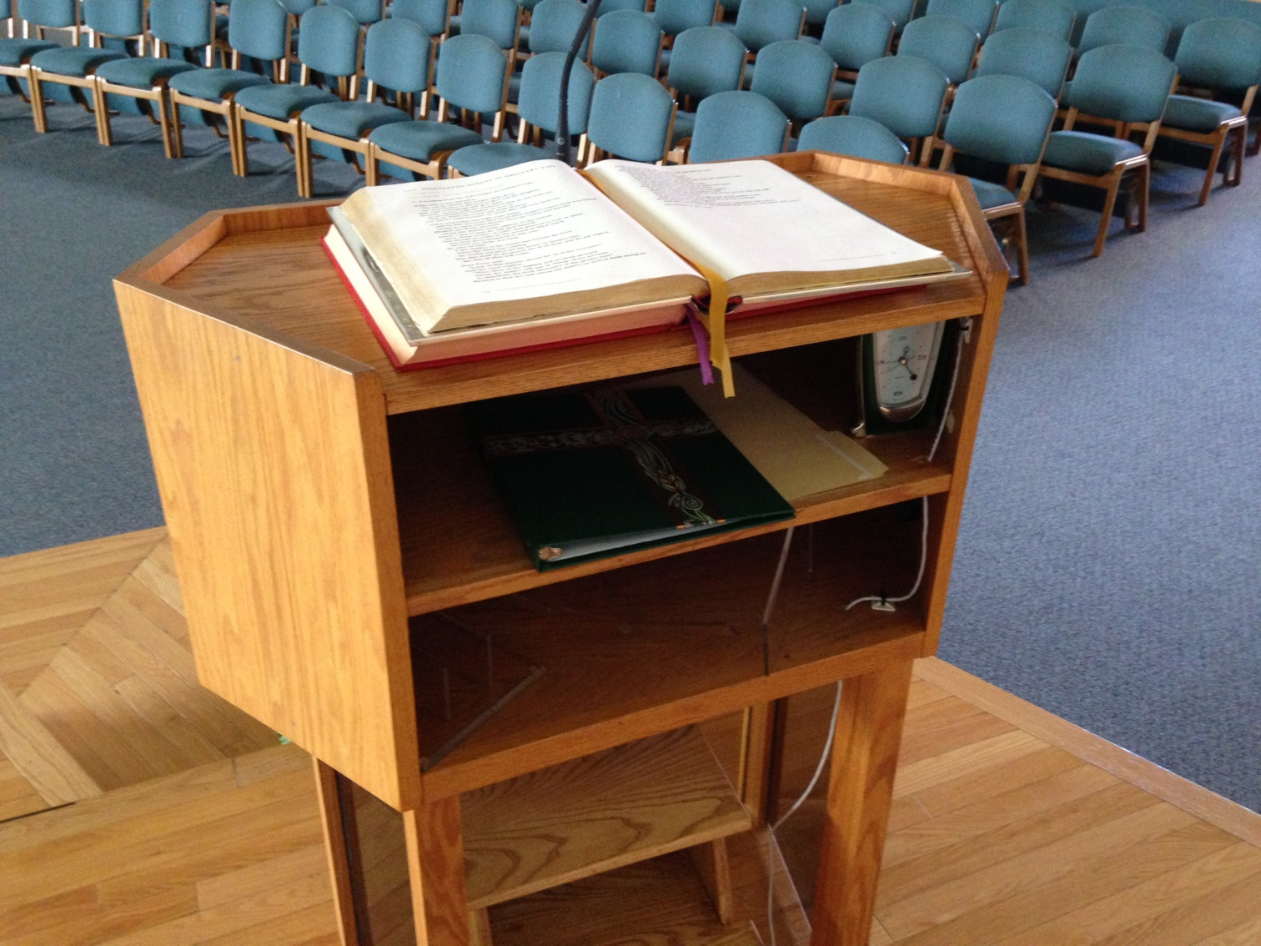
Ambo with prayer book on shelf.

Slide 22
Techniques
Confidence, poise
Clear and steady voice
Pace, clarity, pauses
Practice in front of a mirror

Slide 23
Techniques – continued…
Speed – when your reading pace seems too slow to you, it’s probably about right.
Eye contact – improved by text familiarity and a slower pace.
Project feeling not drama.

Slide 24
Lector’s Ten Commandments
I will remember that it's about God and His WORD, never about me.
I will practice names, and proclaim them with confidence.
I will know the readings, having prayed and practiced them in the week before Mass.
I will honor my family in Heaven in my posture and my prayerfulness.
I will proclaim the living Word with an urgent passion that is alive, not dead.

Slide 25
Lector’s Ten Commandments part 2
I will dress in a way that brings honor to my Father's House and family.
I will not seek affirmations or compliments, realizing all glory belongs to God.
I will respect the ministry, only proclaiming the Word if prepared to do so, and only proclaiming it exactly as it is found in the Lectionary text.
I will support, uplift and pray for others who also seek and proclaim God's Word.
I will honor the opportunity to proclaim the Word and recognize the privilege.

Slide 26
2. If you are not able to keep your assigned Mass, it is your responsibility to find a substitute.
The parish website (www.olcparish.net) includes a contact listing of all ministers.

Slide 27
While you will most likely have been assigned a particular reading for that Mass, be prepared to proclaim both readings, in the event that the other lector does not show for their assigned ministry.

Slide 28
Upon arrival 15 minutes before Mass, check in with the Mass “captain.”
Note: We are sure our lectors will understand if they might be replaced if not checked-in by 10 minutes before Mass.

Slide 29
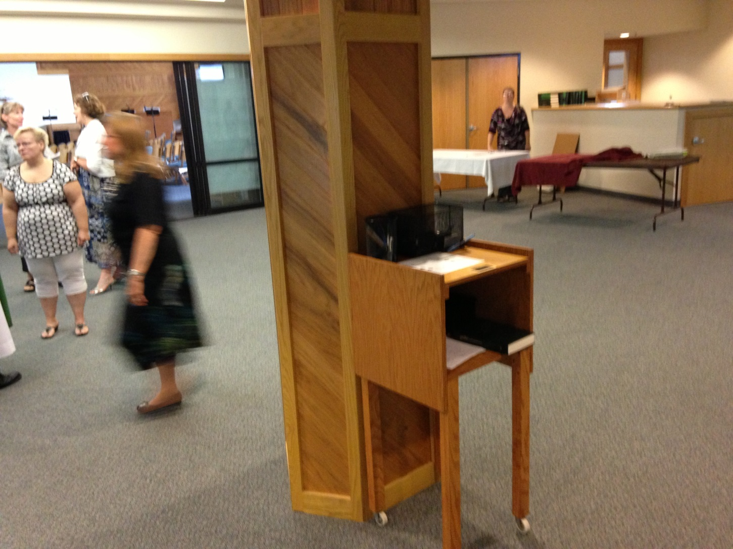
Captain’s station

Slide 30
Sign In
Sheet

Slide 31
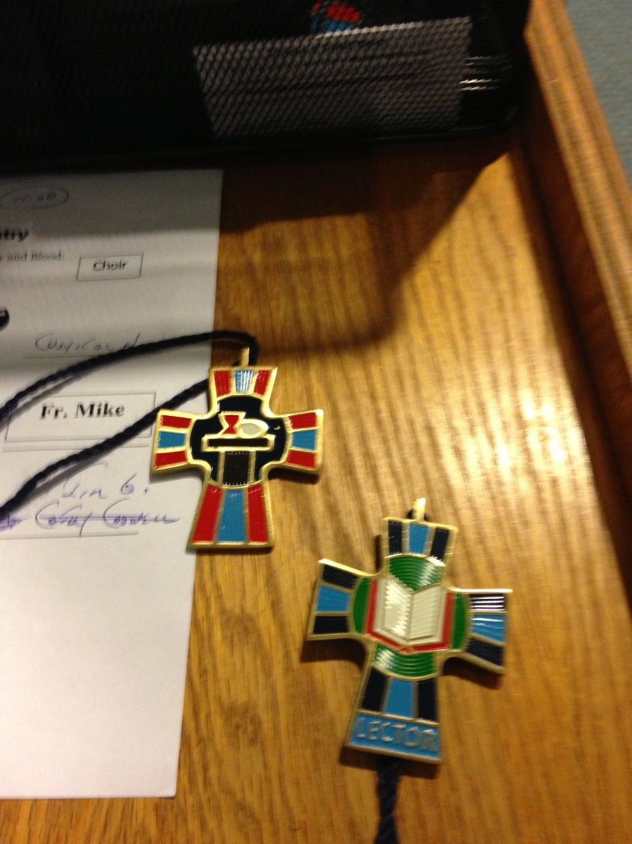
Ministry Crosses

Slide 32
Check that the Lectionary is on the ambo, opened to the correct page.

Slide 33
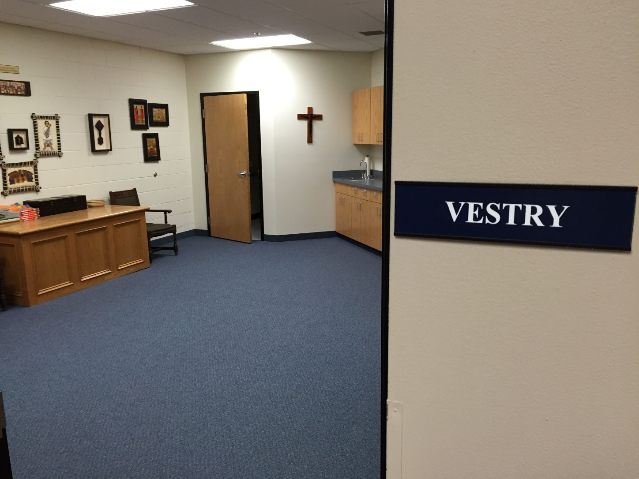
Meet in Vestry for Prayer along with other ministers 5 – 7 min before Mass.

Slide 34
  Person with the 1st Reading
  1st Reading
  Prayers of Faithful (if no deacon)
Person with the 2nd Reading
  2nd Reading
  - Carries in Book of the Gospels
  (if no deacon)

Slide 35
Additional Items:
The Lector should be seated on the Ambo side of the church.
Bow when entering or leaving the sanctuary. Bow is to the Altar when standing outside the sanctuary, never bow to the Lectionary or Ambo.
Wait for the church to settle down before starting to proclaim the Word.

Slide 36
We must always remember that it’s always about proclaiming the Word and never about us.
As a Lector, you will be viewed, and properly so, as a leader in the parish. Your behavior will be watched as a model for others.
Make your own singing, praying and responses sincere and enthusiastic.

Slide 37
In the event that no deacon is serving at the Mass, one of the lectors will walk in the procession carrying the Book of the Gospels.
The Procession 1

Slide 38
The lector will follow the altar servers, holding the Book slightly elevated – such that he/she can see over the top.
The Procession 2

Slide 39
Without pausing at the foot of the Sanctuary, the lector will proceed directly to the back of the Altar and immediately place the Book into the stand.
The Procession 3

Slide 40
In the meantime, the priest and the servers will stop at the foot of the Sanctuary steps, waiting for the lector to place the Book.
After the Book is placed, the lector steps back a step, and all bow to the Altar together.
Procession 4

Slide 41
After the bow, the lector proceeds to his/her seat.
Lectors do no process out at the end of Mass.
Procession 5

Slide 42
New/ Prospective Lectors
Please fill out an interest form.
We do most of our communicating through email.
The complete schedule is posted on the website.

Slide 43
New lector info – continued 1
You can use the website to “block out” your busy days/weekends, but only before the schedule is produced.
Each week we send out ministry reminders.
Family members can be linked to serve at the same Masses.

Slide 44
Prayer & Blessing
Thank you for offering to serve in this ministry.
You will be blessed by it.

